Slide 1

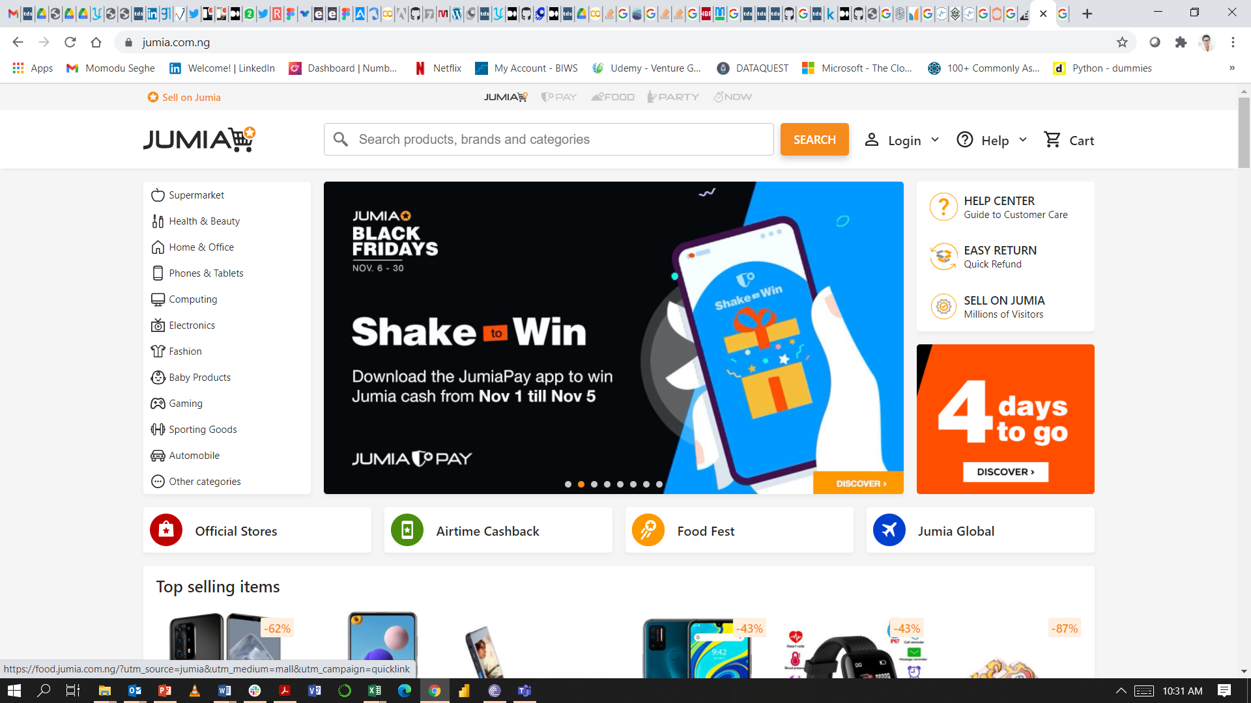
Growth Hacking Case 2
A/B Testing
Seghe Momodu
November 2nd, 2020

Slide 2
The Sorting Algorithm Experiment: Overview
The Data Science team has built a sorting algorithm and A/B tested it by randomly splitting the traffic. The new algorithm aims at maximizing the Click Through Rate (CTR) of the products shown on the catalog and category pages of the Mobile App and Website. The experiment ran from 2020-06-02 and 2020-07-24.
Business Objective: The business objective of this experiment is to maximize click through rates (CTR) on the catalog and category pages on the Mobile App and Web pages.
2. Experiment Objective: The objective of this experiment is to determine whether or not the sorting algorithm should be deployed.
3. Unit of Diversion: The unit of diversion used for this experiment is the platform. This has been chosen as a proxy for a cookie, which is an anonymous identifier. This is based on the assumption that, for a user visible change, it makes sense to assign people as opposed to events. A cookie is known to be assigned to a particular browser or user device.
4. The experiment was modelled in a 50 – 50 split, such that control version A is 50% the total number of interactions. This is to ensure that the distribution of interactions is completely random and not significant in both versions. The significance level (alpha) = 5%
5. The invariant metrics used to ‘sanity check’ the experiment is the Distribution of Interactions by Version for each Platform.
The first sanity check was done for the first 2 weeks beginning 2020-06-02 to 2020-06-16. It was discovered that there was a flaw in the distribution between versions A and B. The split was in a 70 – 30 proportion.
Another sanity check was done between 2020-06-30 to 2020-07-14. This sanity check was in line with the experiment.
6. Hypothesis:
H0: Page visitors that receive version B will not have a higher CTR compared to visitors that receive version A.
H1: Page visitors that receive version B will have a higher CTR compared to visitors that receive version A.
1

Slide 3
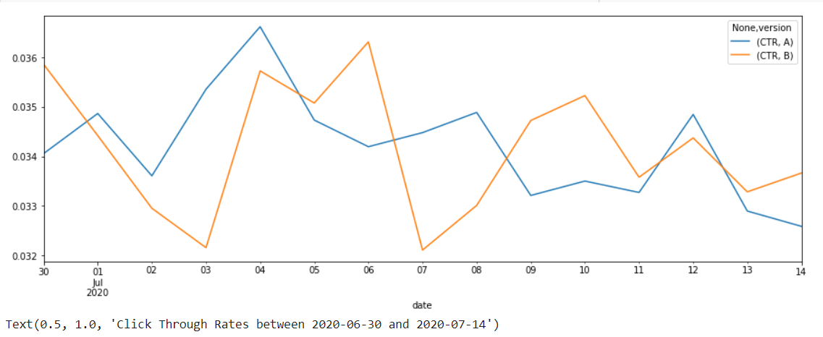
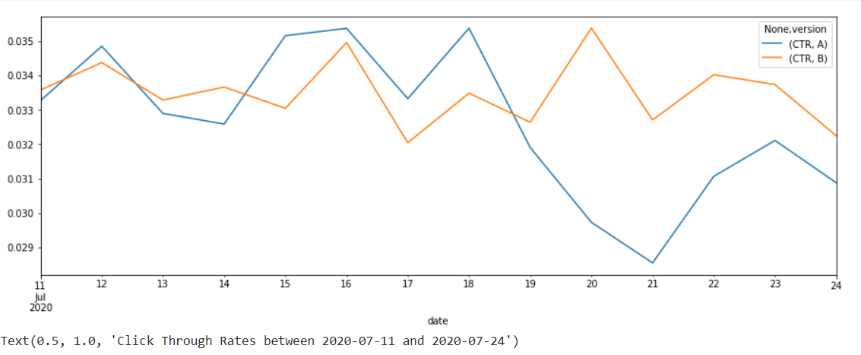
The Sorting Algorithm Experiment: Key Findings
7. The evaluation metric is ‘Click Through Rate (CTR)’. A comparison between the click through rate (CTR) of version A and version B was made and the confidence interval was calculated for the difference whether or not the confidence interval was statistically significant.
8. The overall CTR of version B is slightly higher than version A (0.77% relative increase). The p_value of the difference in the CTR for the two versions and test whether or not the difference was statistically significant. The test statistic used was the comparison between the click through rates of version A and version B. A z-test was conducted to calculate the p-value.
9. The calculated p_value was 0.00355357. This low p_value was indicative of a strong evidence that visitors that receive version B will have a higher click through rate compared to those that received version A. Therefore, the Null Hypothesis was rejected as the results were entirely random and thus, statistically significant.
10. To validate the results, the CTR for two separate two-week date ranges were observed. The charts below summarize the findings. In the two date ranges, it was observed that there were random spikes of the CTR for version B. Thus the results of the experiment was validated.
2

Slide 4
The Sorting Algorithm Experiment: Conclusion and Recommendations
The A/B test for the new sorting algorithm was run successfully according to design specifications.
Conclusions
From the analysis of the metrics, the following conclusions can be made:
Page visits for version B showed a statistically significant change in click through rates than page visits for version A.
Page visits for version B showed randomly higher click through rates than page visits for version A.
The new sorting algorithm observedly led to higher click through rates in page visits of version B.
Recommendations
Based on the results of the analysis of page visits between version A (control) and the version B (experiment), the following recommendation can be made:
The new sorting algorithm should be deployed as it increases the click through rates of product shown on the catalog & category pages of our Mobile App and Web platforms.
3

